Slide 1
Geothermal Project Management February – March 2024
Day 3 Session 4
Geothermal Reservoir Modelling
Michael Gravatt and Team
Engineering Science & Geothermal Institute
University of Auckland, New Zealand

Slide 2
Outline
Introduction to modelling
Geothermal modelling process
Modelling uses
Limitations

Slide 3
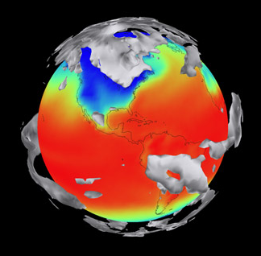
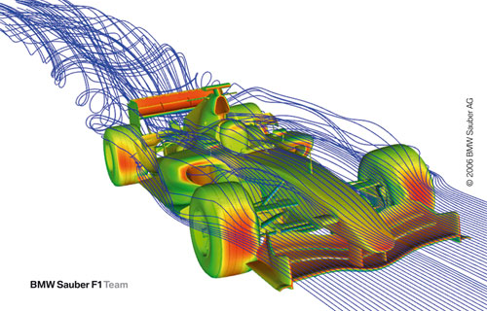
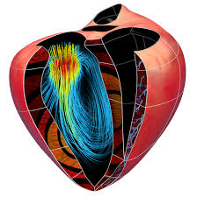
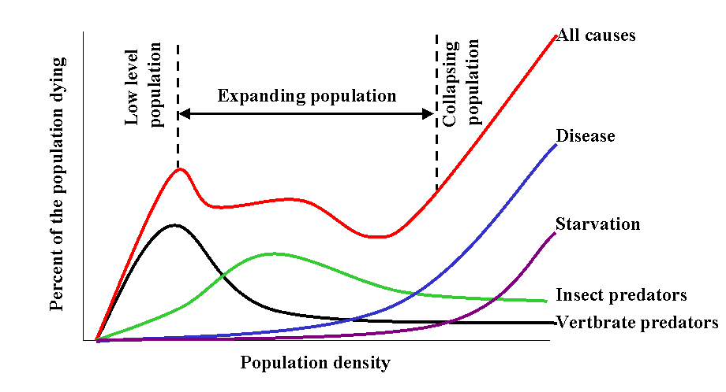
Introduction to modelling
Modelling is used everywhere
Climate
Formula 1
Physiology
Populations

Slide 4
Why make models?
To help understand what is happening or has happened
Sometimes we can’t measure what happened:
Things are too small or happen to fast
You can’t reach what you want to measure – eg deep underground
Measuring data can affect the results – eg pressure sensors on planes
You can’t always put things inside people!

Slide 5
Why make models?
To make predictions about what will happen in the future
Important for planning – eg budgets
Can save a lot of money – eg design costs
Can save a lot of time
Build confidence in decisions – not just from model results but also modelling process

Slide 6
What do models look like?
Simple formula with a few parameters
Spreadsheet
Large complex models based on breaking up the 3D region of interest into many small pieces (finite volume or finite element methods), implemented with simulation software
Model parameters must be selected so that the model results match past history (calibration process)

Slide 7
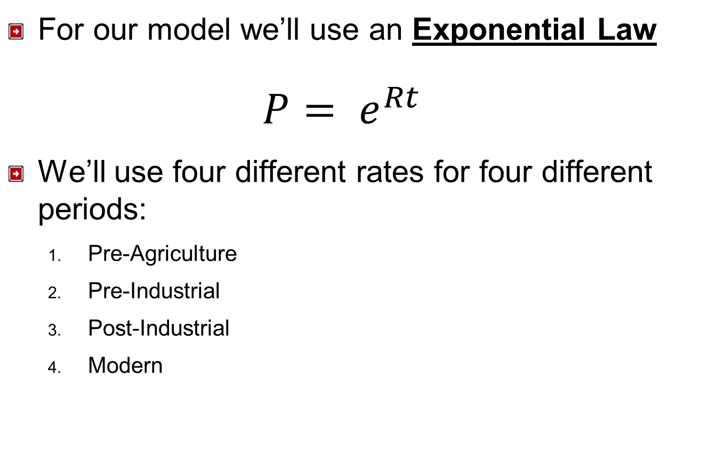
A simple example – matching population growth

Slide 8
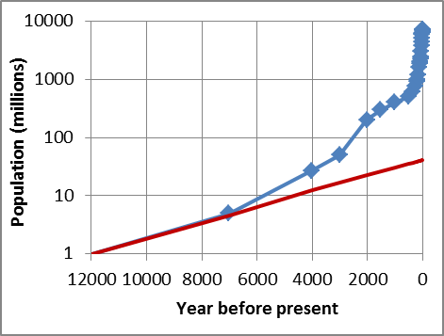
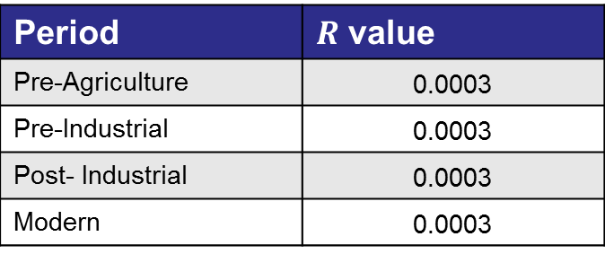
A simple example
Period
Pre-Agriculture | 0.0003
Pre-Industrial | 0.0003
Post- Industrial | 0.0003
Modern | 0.0003
1st attempt:

Slide 9
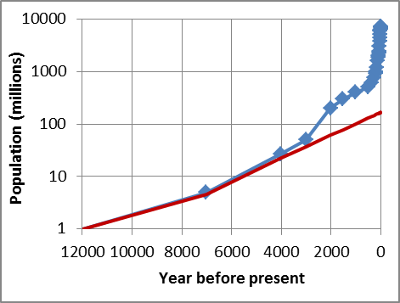

A simple example
Period
Pre-Agriculture | 0.0003
Pre-Industrial | 0.0005
Post- Industrial | 0.0005
Modern | 0.0005
2nd attempt:

Slide 10
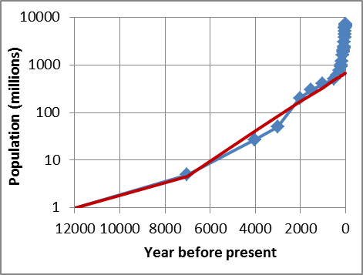

A simple example
Period
Pre-Agriculture | 0.0003
Pre-Industrial | 0.0007
Post- Industrial | 0.0007
Modern | 0.0007
3rd attempt:

Slide 11
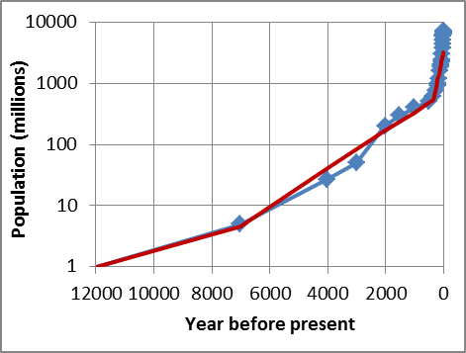
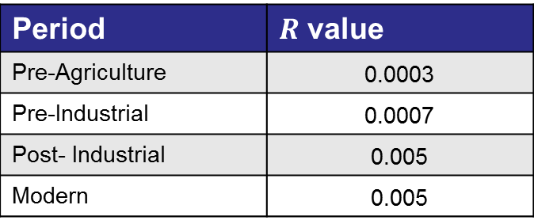
A simple example
Period
Pre-Agriculture | 0.0003
Pre-Industrial | 0.0007
Post- Industrial | 0.005
Modern | 0.005
4th attempt:

Slide 12
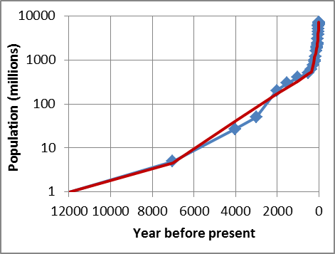

A simple example
Period
Pre-Agriculture | 0.0003
Pre-Industrial | 0.0007
Post- Industrial | 0.005
Modern | 0.0175
5th attempt:
This process is called model calibration

Slide 13
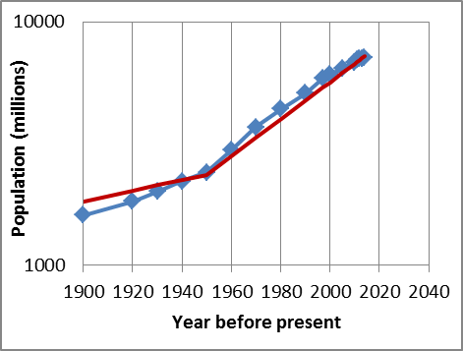
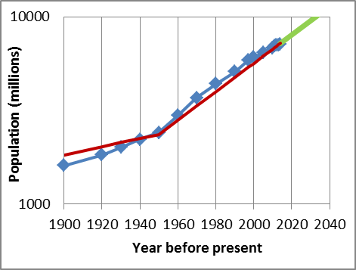
A simple example
Our calibrated model matches historic data
Now we can use it predict the future

Slide 14
Geothermal models
Geothermal models are like our example
They are based on laws and calibrated using real data
There a many different types of geothermal models ranging in complexity – simple lumped parameter up to complex 3D models with 100,000 to 1,000,000 blocks
Stored heat calculations are very simple “models” that follow the Conservation of Heat Law:
Useable Heat = Total Heat – Unusable Heat
(energy you take out) (energy in the ground) (energy that stays in the ground)

Slide 15
Geothermal models
Geothermal reservoir models are much more complicated and follow several laws:
Conservation of Mass
“What goes in must come out”
Conservation of Heat
“Energy cannot be created or destroyed”
Darcy’s Law
Define how hot water and steam move underground

Slide 16
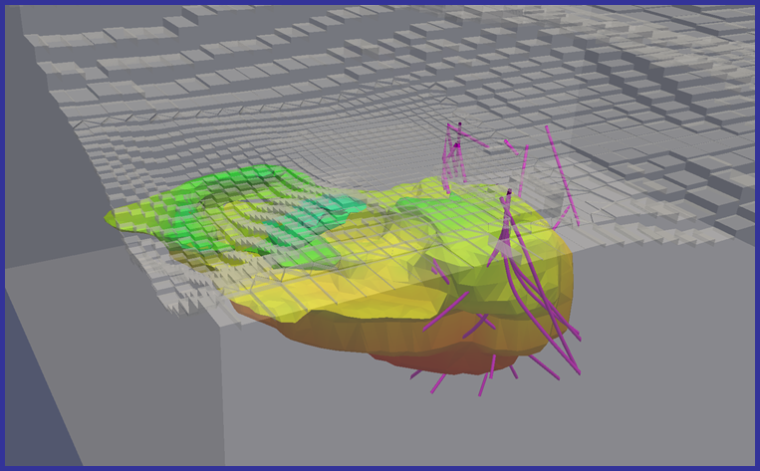
Geothermal models
Before talking about model uses and limitations it is helpful to understand how geothermal models are made

Slide 17
Geothermal modelling initial process
Leapfrog
Gather and analyse data
Create a conceptual model of the geothermal system
Build an calibrate natural state model consistent with the conceptual model
Use the natural state model to make a production model and calibrate with production history data
Run future scenarios using the production model
Steps 3 to 5 are iterative
Leapfrog
Leapfrog

Slide 18
Geothermal modelling update process
Leapfrog
Update data and analysis
Update the conceptual model
Update the natural state model ensuring it is consistent with the updated conceptual model
Use the natural state model to make a production model and calibrate with production history data
Run future scenarios using the production model
Steps 3 to 5 are iterative
Leapfrog
Leapfrog

Slide 19
Gather and analyse data
Gather as much data as possible
From a wide variety of sources:
Geosciences
Environmental sciences
Engineering
Hydrological
Data collected before production occurs is very important!
Some things are impossible to understand before wells are drilled

Slide 20
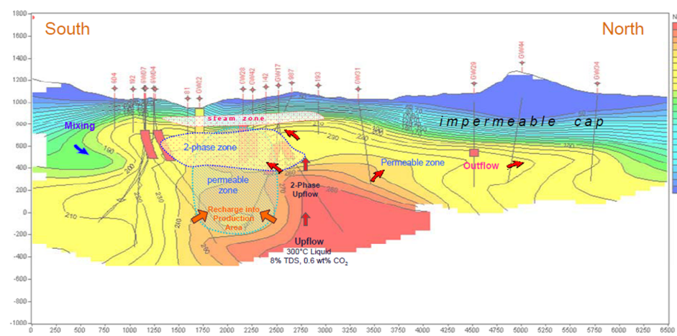
Conceptual model
Combines and distils all the available data
Provides a “conceptual” idea about how the geothermal system behaves
Details are discussed in a separate lecture

Slide 21
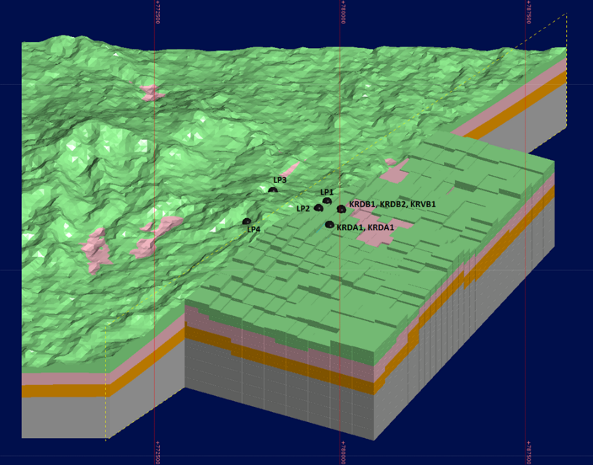
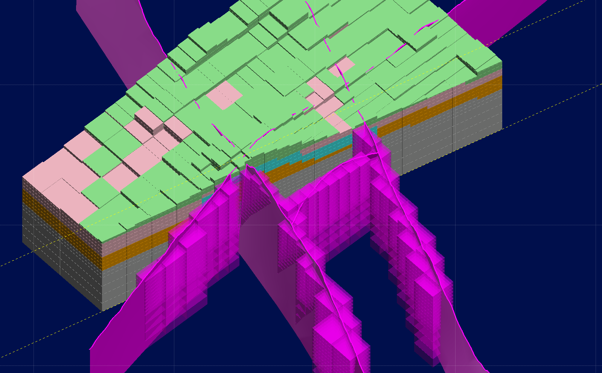
Conceptual model to numerical Model
New tools to create Geological/Geophysical models integrated with numerical reservoir models using LEAPFROG® and TOUGH2
Ensures consistent system representation and allows early numerical model development

Slide 22
Model design
Size and shape of model
Number of blocks, block refinement
Boundary conditions on top, sides and base
Geological structure
All very important matters, but will not be discussed today (we need many more lectures on modelling)

Slide 23
Natural state model
A reservoir model of the system before any production occurred
Model calibrated using pre-production data:
Exploration well data
Surface features (geysers, hot pools, springs etc)
Completion test data from the first production wells
Downhole temperatures (after heating up!)

Slide 24
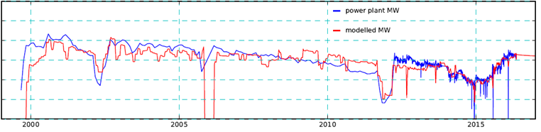
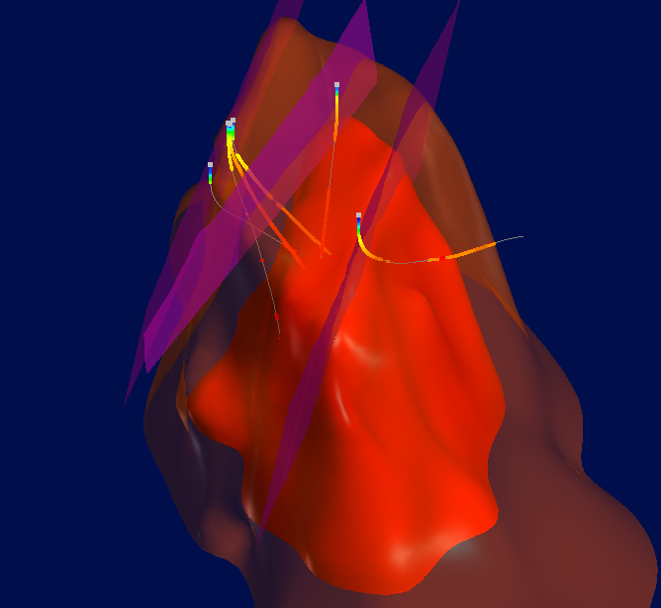
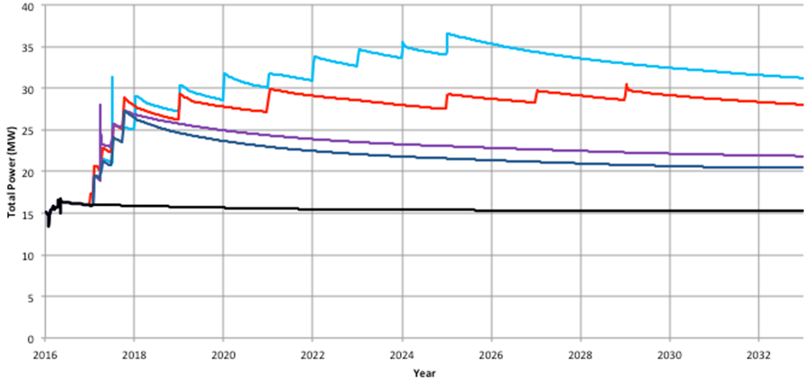
Production model
Reservoir model follows the production history for the system
Transient data are used to calibrate the model
Pressure decline
Enthalpy changes
etc

Slide 25
Future scenarios
Once a model has been calibrated using natural state and production data it can be used to predict the future
The more good data used for calibration the more accurate the predictions are likely to be
Scenarios are set up that define expected future production, well locations, reinjection strategies etc
How scenarios are created depends on what the model is to be used for

Slide 26
Modelling uses
Geothermal reservoir models are mainly used to predict the following:
How long a system can be economically exploited
What new wells are required to maintain production
How a system will respond to different rates of production
How to best re-inject fluid into a system
How the natural geothermal features will react to the systems exploitations
What other environmental effects may occur
What is the resource potential of a system?

Slide 27
Modelling uses
Which of these are important to a developer?
How long a system can be economically exploited
What schedule of new wells are required to maintain production
How a system will respond to different rates of production
How to best re-inject fluid into a system
How the natural geothermal features will react to the systems exploitations
What other environmental effects may occur
What is the resource potential of a system?

Slide 28
Modelling uses
Which of these are important to a policy maker?
How long a system can be economically exploited
What schedule of new wells are required to maintain production
How a system will respond to different rates of production
How to best re-inject fluid into a system
How the natural geothermal features will react to the systems exploitations
What other environmental effects may occur
What is the resource potential of a system?

Slide 29
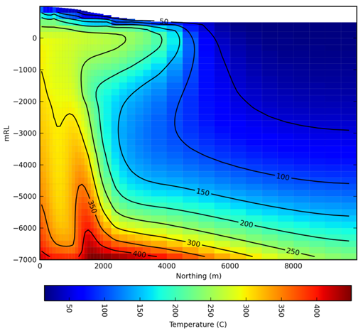
Modelling uses
Reservoir models are also used for scientific research
How do geothermal systems form and why?
How do geothermal system interact?
What are the fundamental processes that occur in geothermal systems?
etc

Slide 30
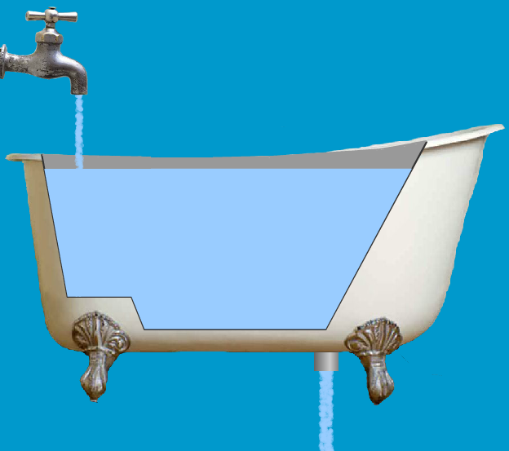
How long a system can be economically exploited
In most cases the amount of energy taken out of a geothermal system by production is more than the natural recharge
Natural recharge
Energy taken out

Slide 31
How long a system can be economically exploited
At some point it will become uneconomic to continue exploitation and the production will have to stop while the pressure recovers in the system
This may be in 25 years, 35, 50 or even 100
Stored heat calculations give simple estimates, useful only as a first guess
Reservoir models represent the detailed physical processes and therefore are much more accurate

Slide 32
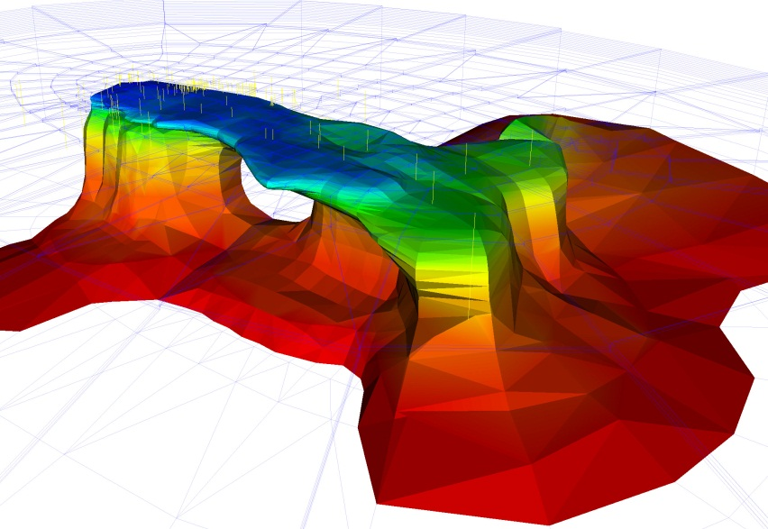
How long a system can be economically exploited
Brief History of Wairakei:
Started operation in late 1958
Pressures dropped quite soon
Pressure decline of 25bar by 1965
Panic! Send for the modellers!
It has settled down and continues on, perhaps for 100 years

Slide 33
How long a system can be economically exploited
In New Zealand regulators require reservoir models to be used as part of the permitting process
In many other countries it may become a requirement for companies listed on the stock exchange

Slide 34
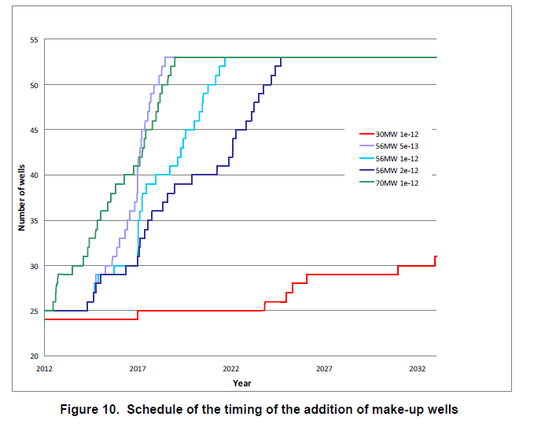
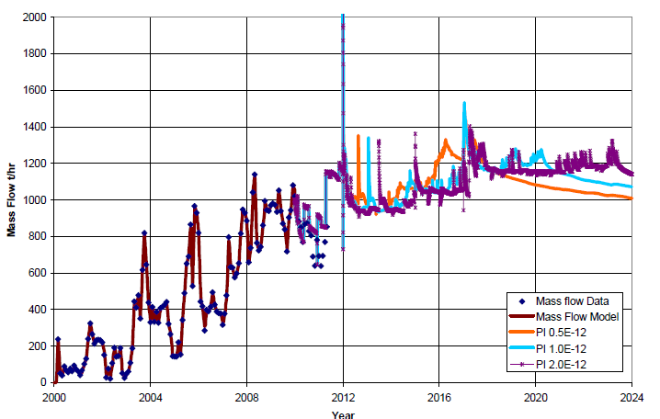
What schedule of new wells are required to maintain production
As pressure declines locally, wells will produce less.
Reservoir models are used to predict when new make-up wells must be brought online to maintain power production

Slide 35
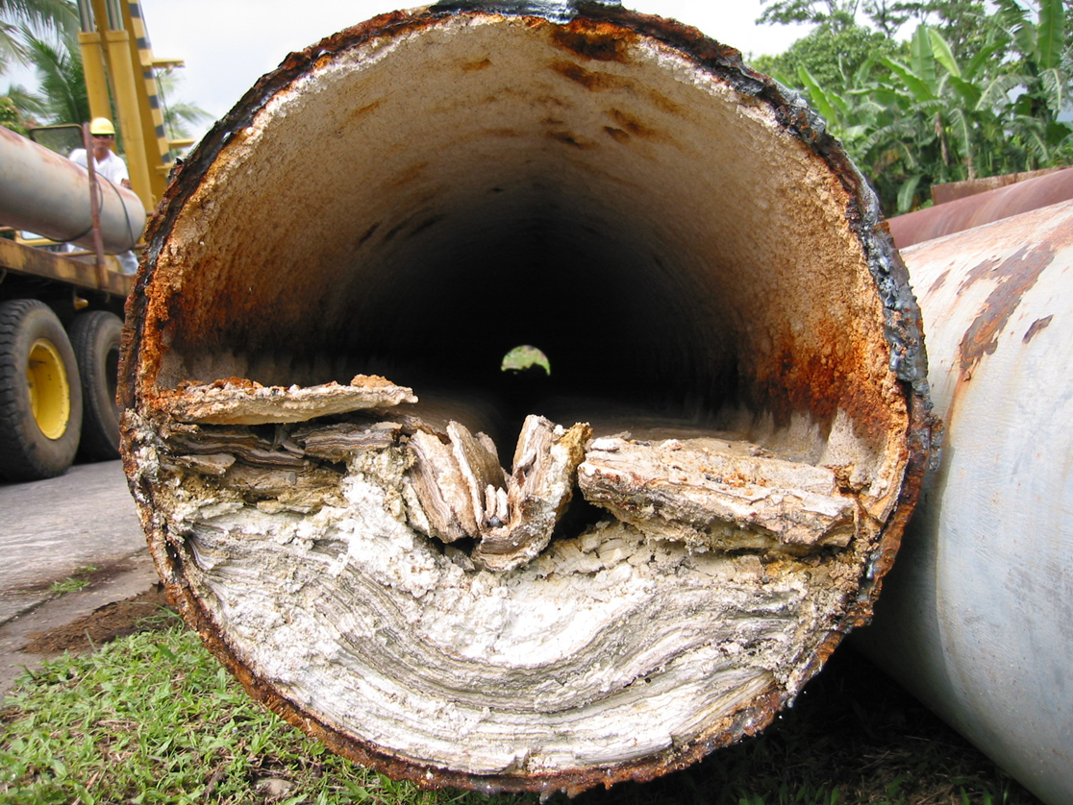
What schedule of new wells are required to maintain production
Reservoir models can also be used to plan extra capacity needed for regular maintenance

Slide 36
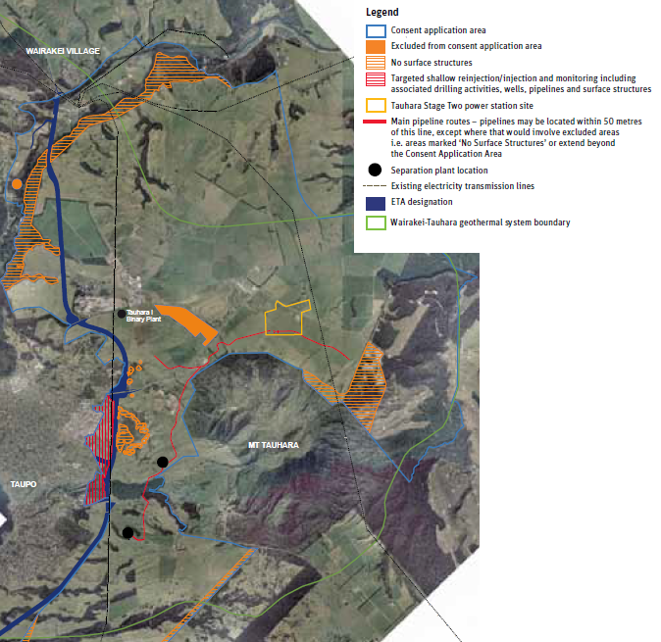
How a system will respond to different rates of production
The rate of production affects how quickly pressure in a system declines
It also affects the schedule of new wells to be drilled
Different pressure decline
rates will affect the
environment differently
Tauhara expansion (source: Contact)

Slide 37
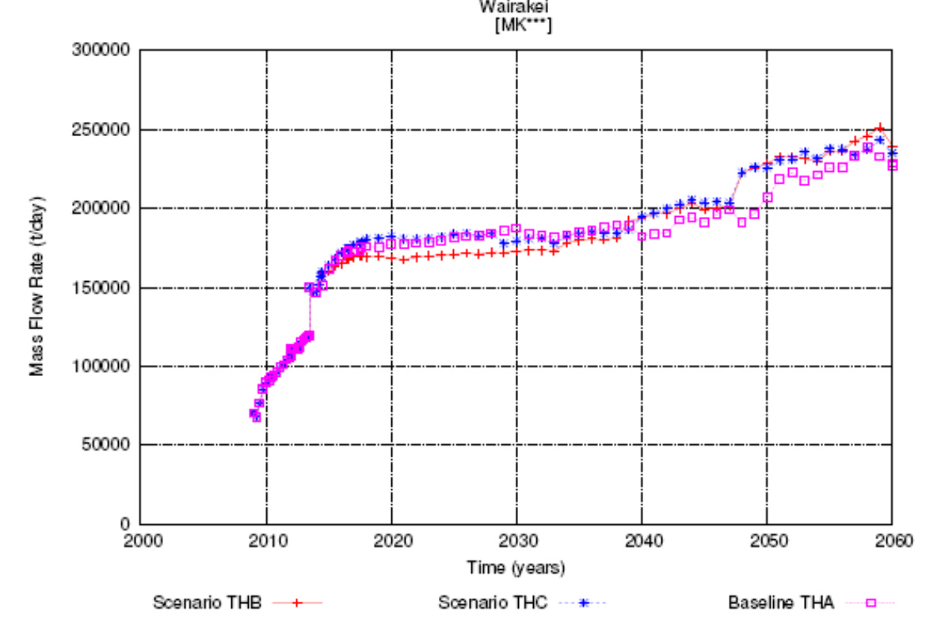
How a system will respond to different rates of production

Slide 38
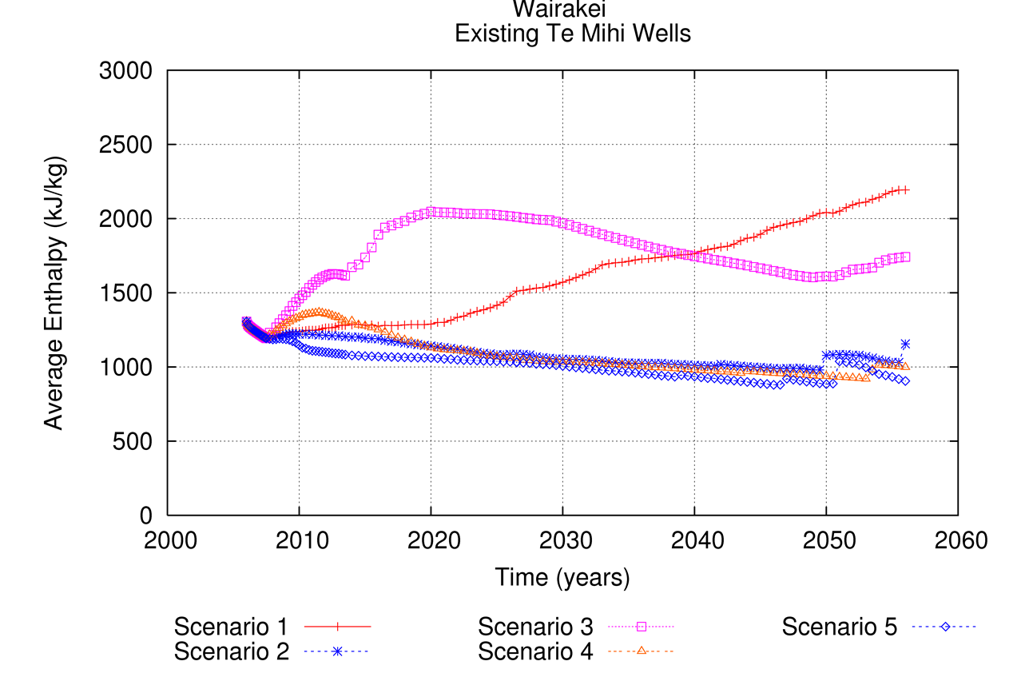
How a system will respond to different rates of production

Slide 39
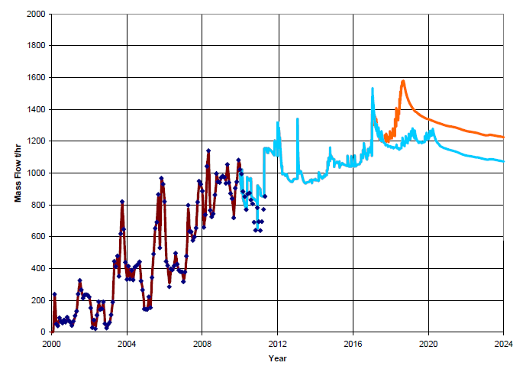
How a system will respond to different rates of production

Slide 40
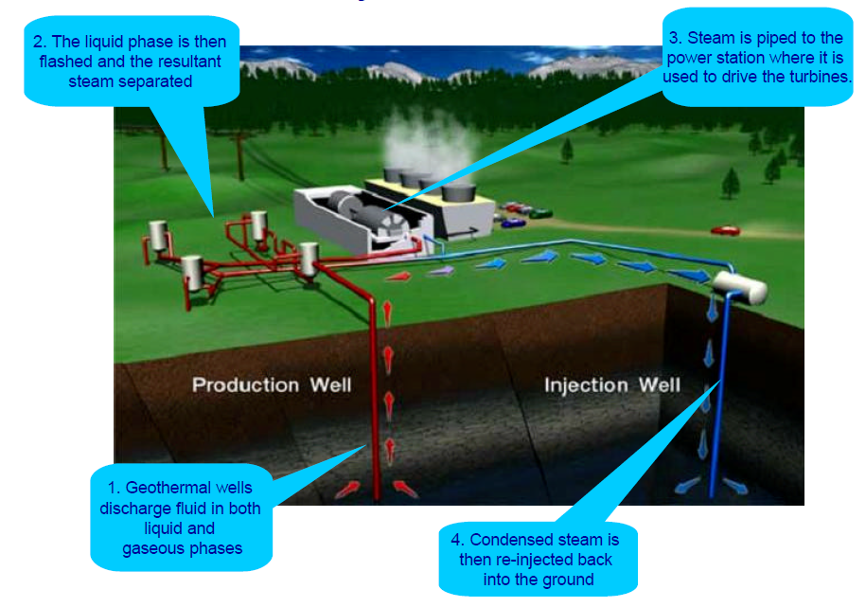
How to best re-inject fluid into a system
Re-injection is carried out for two main reasons:
To slow down the rate at which the pressure in the system declines (pressure support)
To safely dispose of extracted fluid

Slide 41
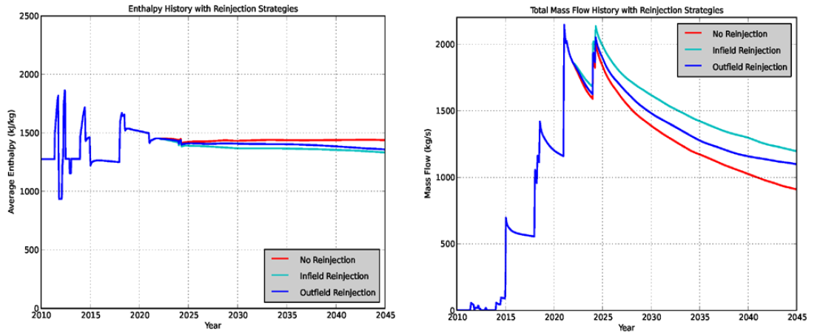
How to best re-inject fluid into a system
For pressure support reservoir
models are used for the
following:
Indicate where best to re-inject
How much to re-inject
At what temperature
The objective is to support
production while avoiding
thermal breakthrough
(source: Kipyego 2013)

Slide 42
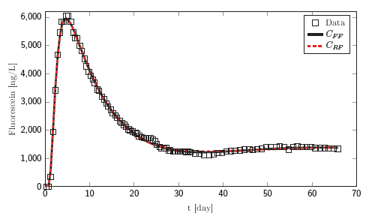
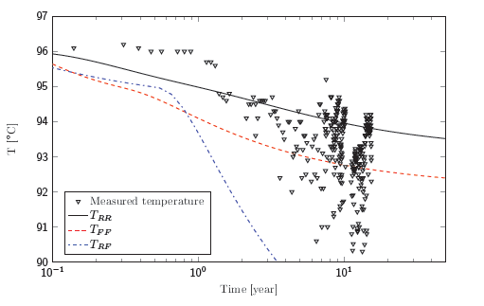
How to best re-inject fluid into a system
For fluid disposal the objective is to determine where large quantities of fluid can be injected without affecting production or the environment
Can simulate tracer tests to improve calibration
Tracer simulations (source: Bjarkason 2014)

Slide 43
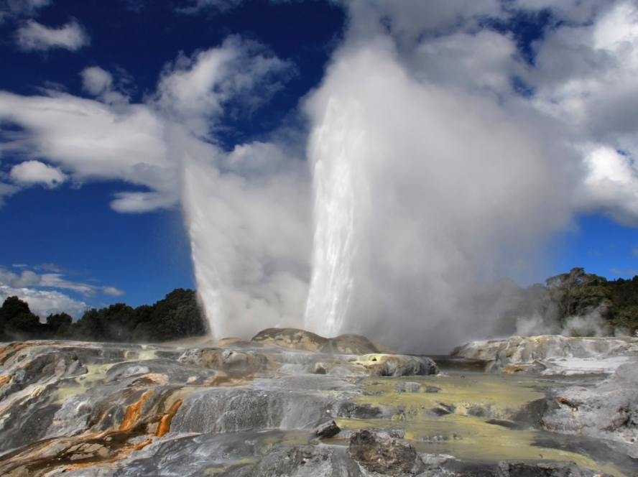
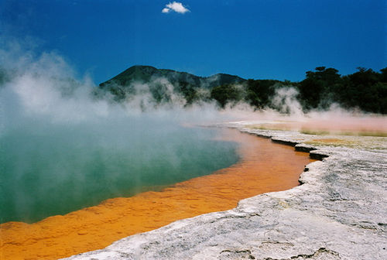
How the natural geothermal features will react to the systems exploitation
Depending on the connection between them, surface features can be affected by production
In Rotorua in New Zealand a borehole closure programme was implemented in 1980 to protect important natural features

Slide 44
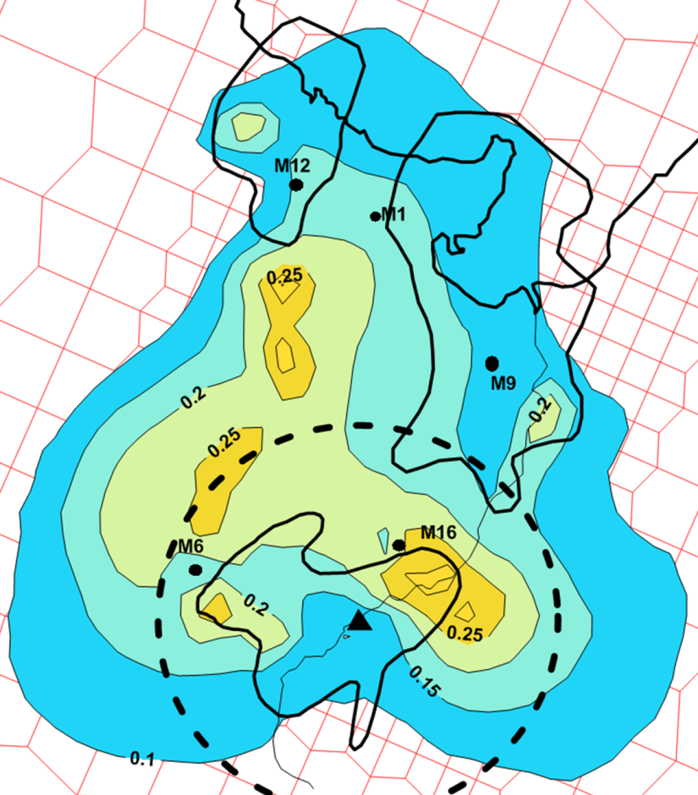
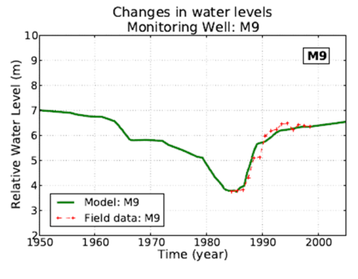
How the natural geothermal features will react to the systems exploitation
(source: Ratouis 2014)

Slide 45
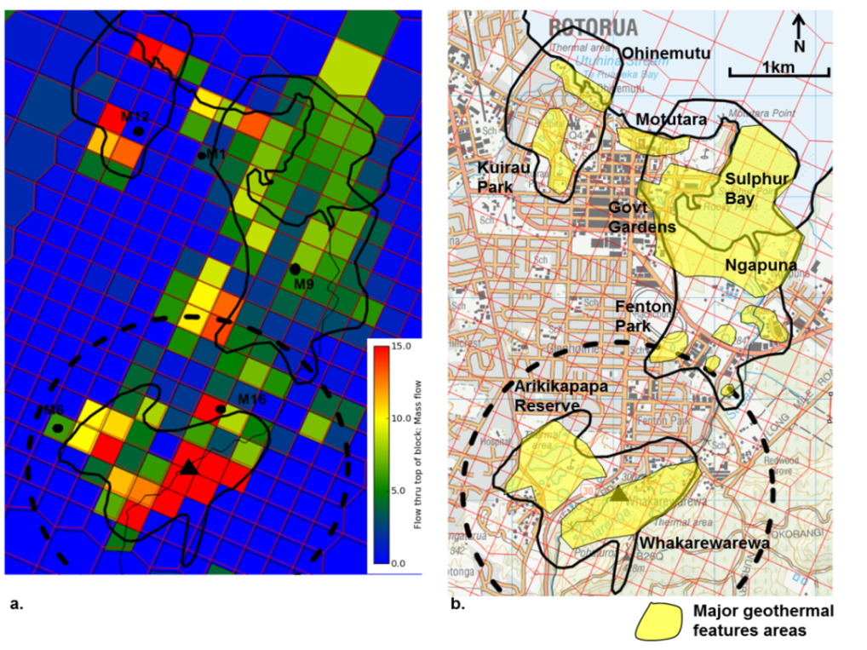
How the natural geothermal features will react to the systems exploitation
There is renewed interest in more exploitation of the Rotorua system
Our reservoir model will be used to assess the likely impact of any future increase on protected surface features
(source: Ratouis 2014)

Slide 46
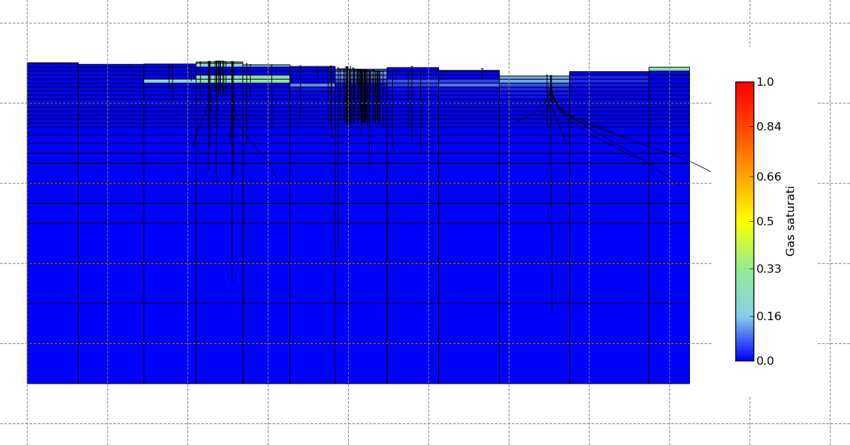
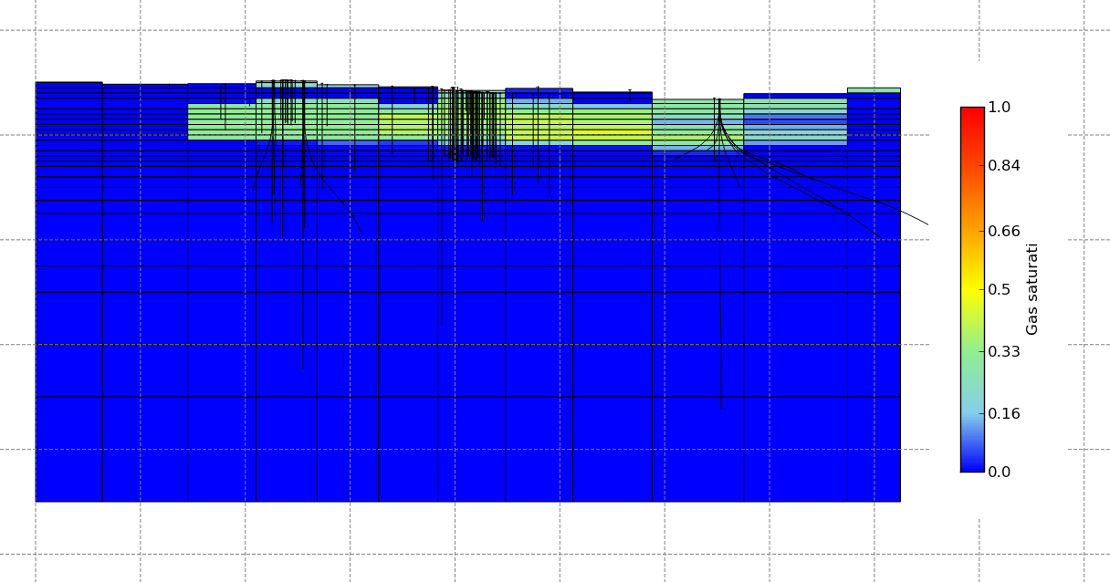
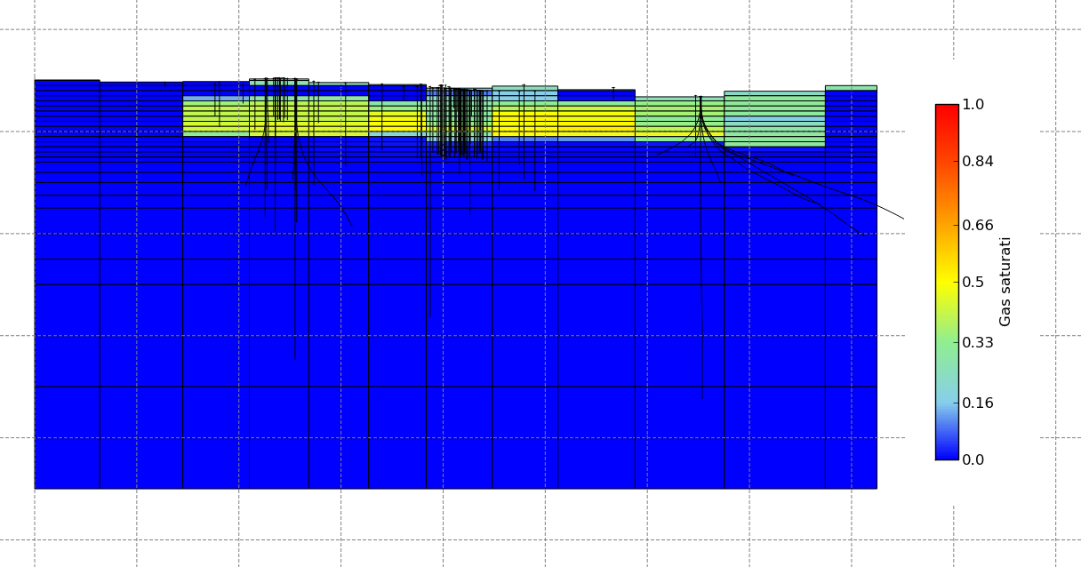
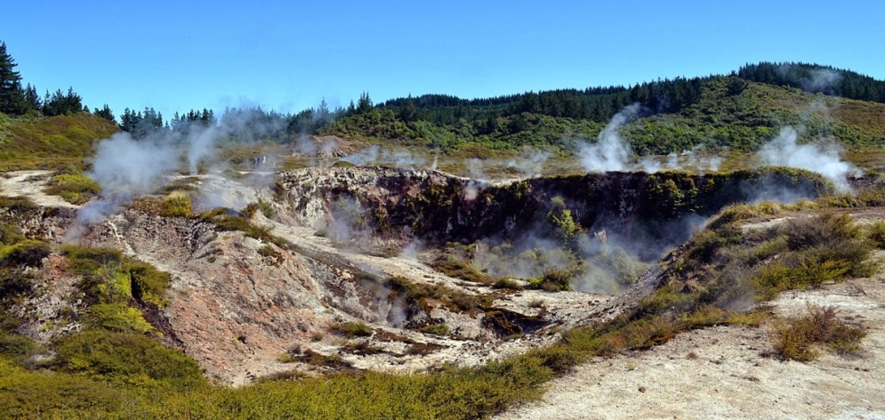
How the natural geothermal features will react to the systems exploitation
In some cases production creates new surface features!
Models can help predict this
1953
1973
1993

Slide 47
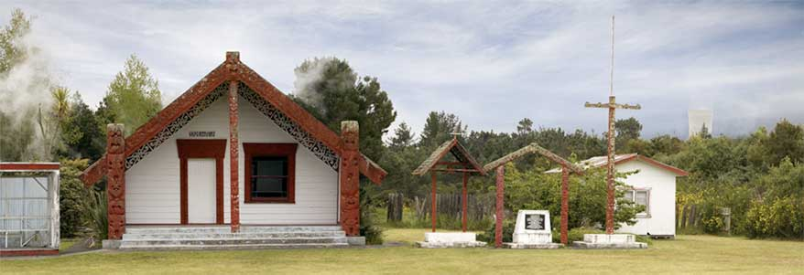
What other environmental effects may occur
Many environmental effects are controlled by the pressure and temperature in the geothermal system
Reservoir models predict these and so can be used to predict environmental effects
A common environmental effect is subsidence
Ohaaki Marae

Slide 48
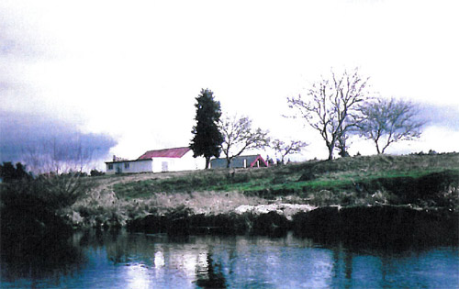
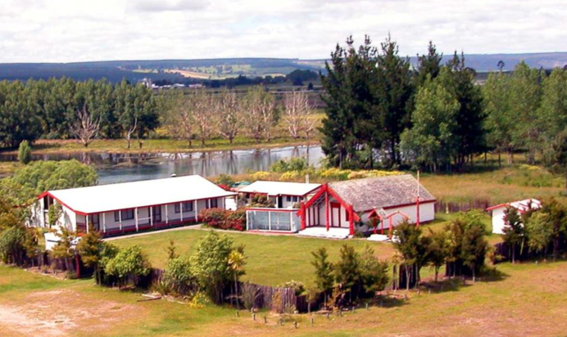
What other environmental effects may occur
Subsidence of nearly 10m affecting cultural meeting house
1978
Today

Slide 49
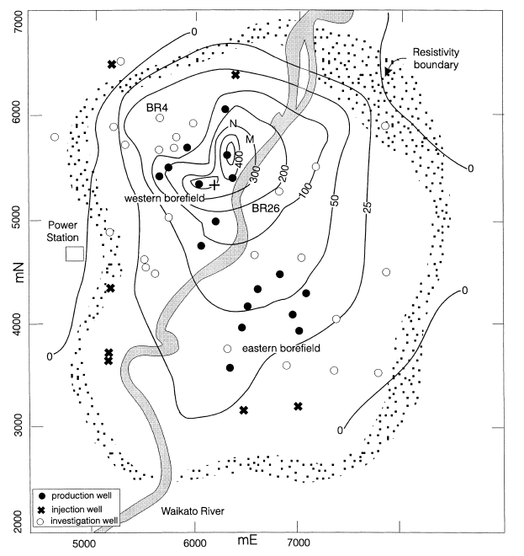
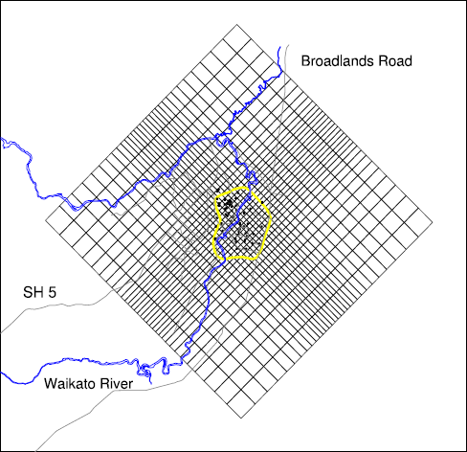
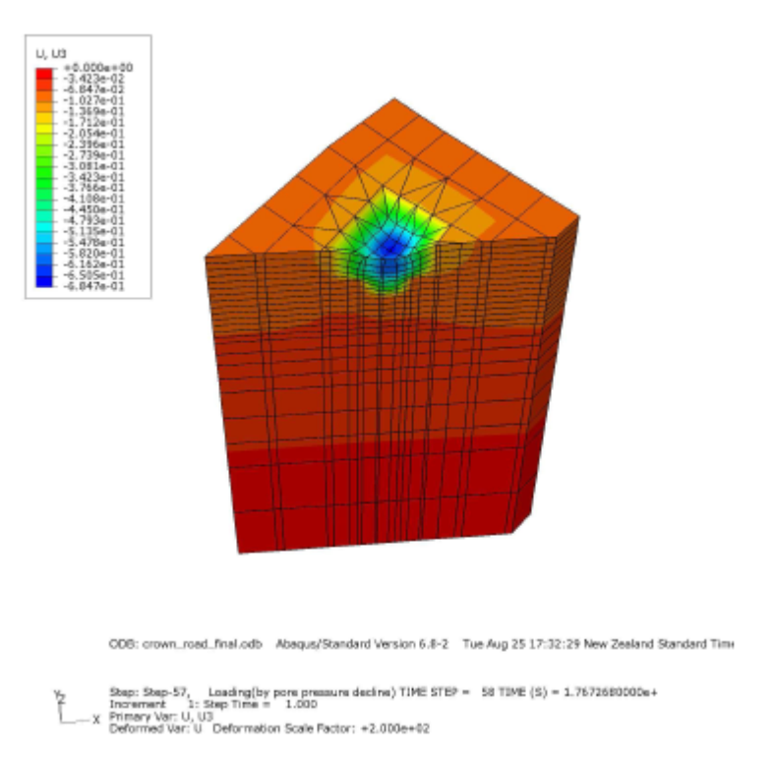
What other environmental effects may occur
Ohaaki reservoir model
Subsidence rate per year (source: Allis)

Slide 50



What other environmental effects may occur
Subsidence can also have an impact on the power plant
Expanding gap filled twice already

Slide 51
Modelling uses
Small models of individual wells
Analyse well performance
Estimate well properties
Production or injection

Slide 52
Limitations of Modelling
Do you think our estimate of global population will be correct?
No!
“All models are wrong…”
“… but good models are useful”
Every model has assumptions that limit what it should be used for and what it can tell us.
It is important to understand what reservoir models cannot tell us

Slide 53

Drilling Success
Reservoir models cannot:
Predict probability of drilling success
Tell you exactly where to drill a well
Predict exactly where good permeability exist
Predict problems with casing, cementing etc
Predict well performance before drilling
Reservoir models calibrated with good data can:
Tell you where hot, high enthalpy fluid is most likely to be
Predict where good average permeability exist
Predict future well performance following initial testing

Slide 54

Operations
Reservoir models cannot:
Predict operational problems
Predict mechanical failures
Predict human error
Predict economic decisions
Reservoir models can help:
Plan contingency in resource availability
Predict the effects of unexpected, long-term changes in production

Slide 55
Chemistry
Standard reservoir models cannot:
Predict where scaling will occur and how quickly
Predict which wells will be affected by high NCG content
If you want predictions like these you must:
Gather accurate data about chemistry in the system
Include chemistry in the reservoir model – this can make models much more complicated
Calibrate the model using the chemistry data
For scaling the results from the reservoir model must often be used in another smaller model of the components in question

Slide 56


Chemistry
Measured and modelled chloride concentrations (sources: Stewart, Setiadi)

Slide 57
Calibration Data
It is very important for all aspects of a geothermal development that good data is gathered regularly
Models without much data for calibration or poor quality data are of limited use
Natural state data is important – if you don’t know where you started its hard to know where you will arrive!

Slide 58

Statistics and uncertainty
Standard reservoir models are not statistical models
They can be used as part of Monte Carlo simulations but this can be computationally expensive
With fast new simulators and cloud computing it is now possible
Decision makers should now expect some analysis of uncertainty in their model forecasts

Slide 59

Uncertainty Quantification
Use advanced modelling to run thousands of models to provide ranges of forecasts
Shows the uncertainty of model forecasts supporting much more robust decisions
This is called Uncertainty Quantification
Successfully applied to commercial projects:
Ohaaki
Lihir
Rotorua
Karaha
Sungai Penuh
Bukit Daun
Sorik Merapi
Now a standard deliverable at GI

Slide 60


Geothermal Resource Assessment
The traditional method for Geothermal Resource Assessment is a Stored Heat Calculation
Developed over 50 years ago
Very simple model to calculate the energy that can be extracted
Monte Carlo sampling is carried out over a very small number of parameters to create a range of forecasts
The Recovery Factor is a very important and very uncertain parameter in a stored heat calculation

Slide 61
Geothermal Resource Assessment
Fast, Consistent Model Setup
Uncertainty Quantification
Fast Simulations
with Waiwera
Geothermal Resource Assessment
Geoscience Exploration Data
Mathematical Tools
Data Space Inversion
PEST
iTOUGH2
…

Slide 62


Geothermal Resource Assessment
We use the best available geoscientific estimate of the system
Then we generate thousands of possible models
3D geological model in Leapfrog Geothermal®
Downhole Temperatures for Future Wells from thousands of possible models

Slide 63

Geothermal Resource Assessment
We use the best available geoscientific estimate of the system
Then we generate thousands of possible models
But only keep the models that agree with the geoscience exploration data
3D geological model in Leapfrog Geothermal®
Downhole Temperatures for Future Wells from thousands of possible models

Slide 64


Geothermal Resource Assessment
Then we run realistic maximum energy extraction scenarios on all remaining models using coupled wellbore simulations
Statistics for the resource potential can then be calculated:
P50 = 88MW
P90 = 37 MW
P10 = 150 MW

Slide 65

Geothermal Resource Assessment
Stored Heat Calculation | Reservoir Modelling + Uncertainty Quantification
Uses a single, simple representation of the geology | Uses many different likely representations of the geology
Uses the resistivity boundary | Uses the full 3D resistivity data
No physics included in model or Monte Carlo samples | Subsurface physics included. Model samples that are not geothermal systems consistent with data are excluded
Only simple temperature data included | All measured exploration data can be included and used to constrain uncertainty
Relies on the problematic Recovery Factor | Realistic maximum production rates can be calculated for each sample including representative wellbore models

Slide 66
Summary
Reservoir modelling is an invaluable tool for understanding geothermal systems and predicting their behaviour
It is important to know what questions the modelling is trying to help answer and what the model’s limitations are
Ensure the reservoir model is consistent with conceptual model of the system based on all the available data

Slide 67
Summary
Make sure reservoir modelling work is done following best practices
Policymakers/regulators may start requiring this soon
Be cautious of modelling work that always gives you the results you hope for!
More in:
O'Sullivan, M. J., & O'Sullivan, J. P. (2016). Reservoir Modeling and Simulation for Geothermal Resource Characterization and Evaluation. In R. DiPippo (Ed.), Geothermal power generation: developments and innovation. Woodhead Publishing.

Slide 68

Summary
Start modelling early!
Gather good data at the start of a project and continue throughout the project
Regularly update your model to ensure you get the most value out of it
Regard modelling as a routine, continuing process
Compared to the other costs in geothermal projects modelling is cheap!

Slide 69
Thank you!

